Slide 1
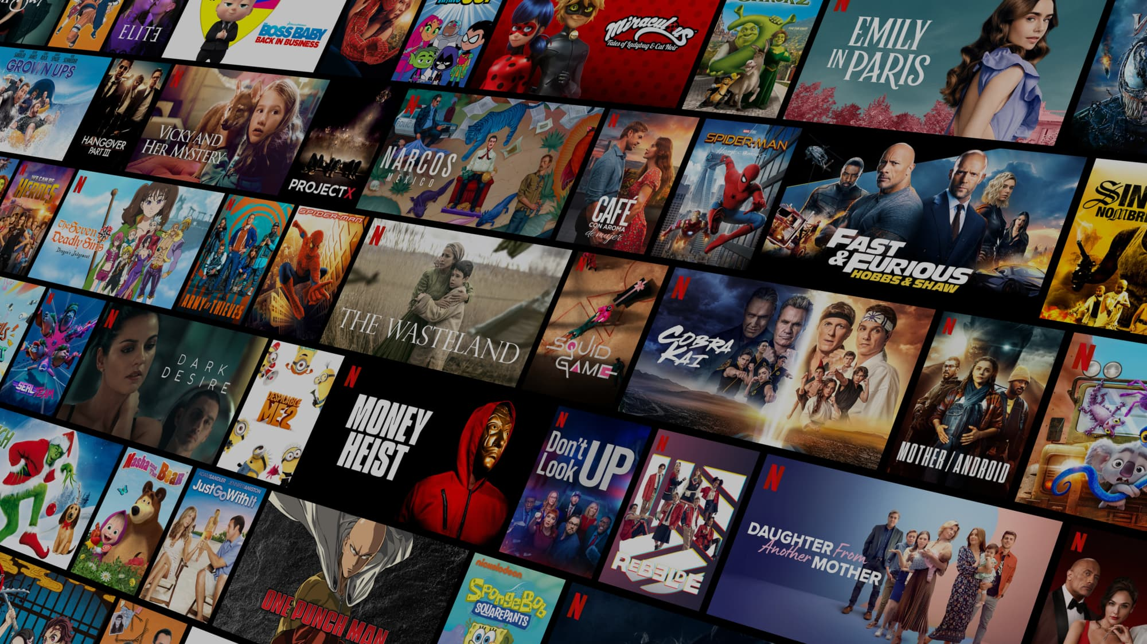

Makayla George IDP
Notes:
14 slides max

Slide 2
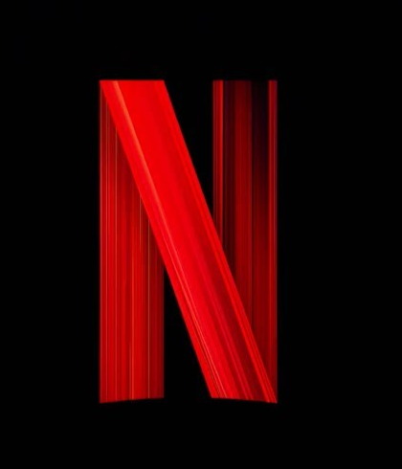
Agenda
Introduction
Market Analysis
Strategic Issue Diagnosis
Segmentation
Hypothesis Development
Hypothesis Testing (1-3)
Key Question
Solution Development (1-2)
1

Slide 3
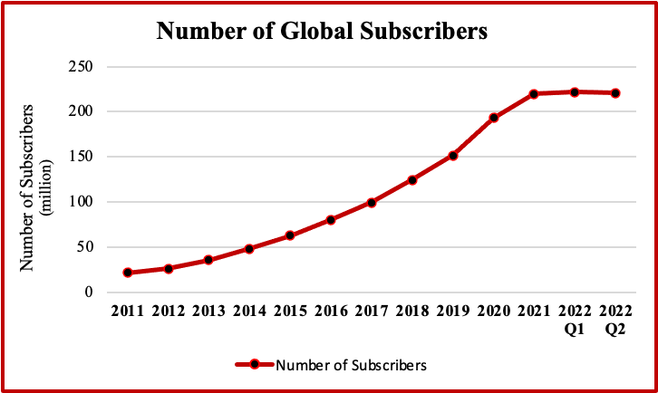
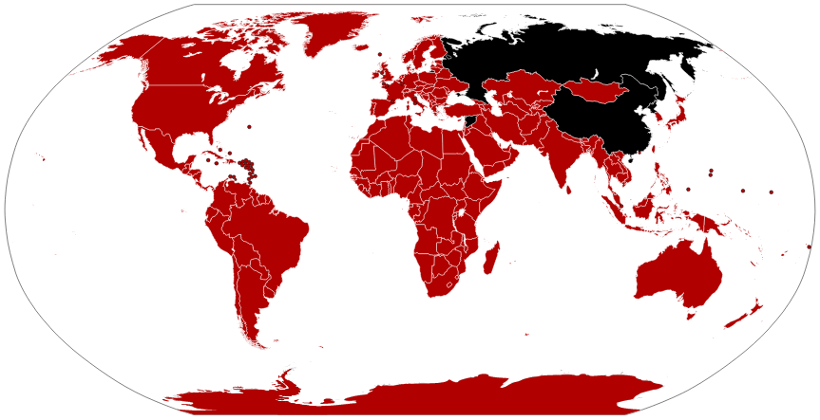
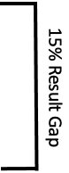
Netflix is a leader in the entertainment and streaming industry with yearly exponential revenue growth
Company Profile
11,300 employees
29.7 bln in revenues
220.67 mln subscribers
190 countries
North America makes up their largest geographic consumer segment
Value Adding Features
There has recently been a 0.97 mil drop in subscribers in recent quarters, the most substantial loss in years
Offline Downloads
Original content
Exclusive series
Large library
AI based content recommendations
Channels
Netflix currently provides products exclusively through online channels
Services are available through most IOT devices
2
*See appendix revenues over time

Slide 4

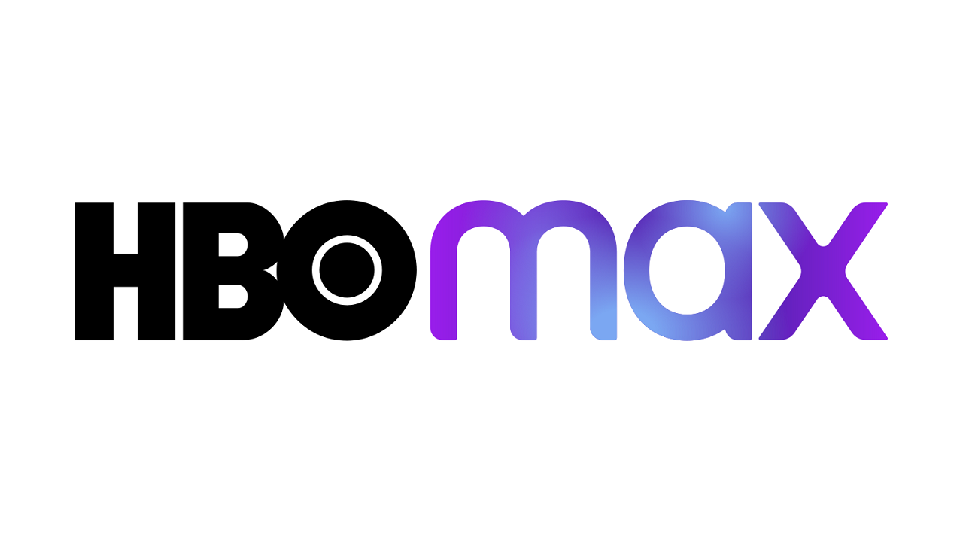


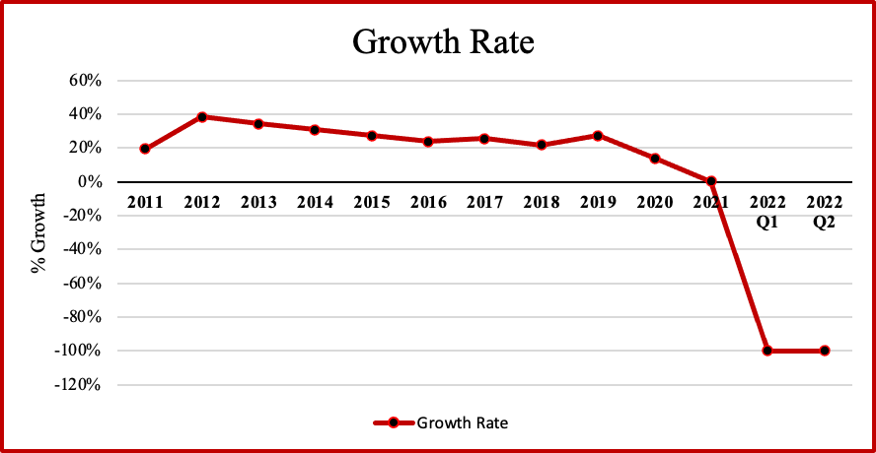
The market has become highly competitive over time and Netflix has suffered
Market Context
The streaming market was valued at 59.14 billion in 2021
Increase in mobile phone adoption and desire for cloud based solutions has fueled market growth
Many competitors have emerged and the market is highly saturated in the US
Performance Analysis
In recent years there has been a significant decrease in Netflix growth in US markets
The US & Canada are responsible for 43% of revenues
High industry growth combined with low company performance points to a strategic issue within the firm
If the company wants to continue to be successful it needs to find ways to differentiate and compete with competitors
3

Slide 5
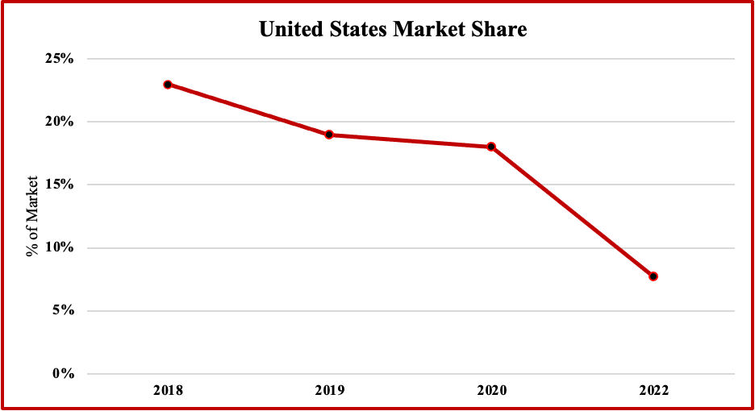
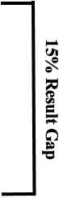
Netflix needs to recapture lost market share and better compete with other services
Initial Situation
Netflix is a large competitor in a highly competitive market. They are currently decreasing in market share and losing popularity among consumers.
Disturbing Event
Major entrants into the streaming industry. Release of major competitor (Disney+) in late 2019.
Desired Result
Increase market share by 15% and get back to market dominance
Undesired Result
Continue to lose subscribers and market share to other competitors
4

Slide 6
Segmenting customers by subscription, user type, and frequency reveals where efforts should be focused
Monthly
Segment has been eliminated because individual users will not need multiple screens or account and this segment is likely negligible
Individuals
Annually
Premium
Monthly
Family
Annually
The standard plan is the most popular Netflix subscription. Most netflix users share their accounts with others. In order to reach the largest segment and make a big impact, Netflix should focus their efforts on these segments.
Monthly
Individuals
Users
Standard
Annually
Monthly
Family
Annually
Monthly
Individuals
Basic
Annually
Monthly
Segment has been eliminated because families will need multiple screens and accounts and this segment is likely negligible
Family
Annually
5

Slide 7
Content, cost, and marketing are likely to be the primary drivers of Netflix’s strategic issue
Score
Policies
6
Service
Technical Issues
6
Internal Factors
Marketing
9
Bad Content
10
Content
Decreasing Market Share
Not Enough Content
5
Relative Cost
8
Competitors
External Factors
Low Differentiation
7
General Economy
7
6
*See appendix for score breakdown

Slide 8
To determine the best strategy for increasing market share, these hypothesis must be tested
Hypothesis | Assumptions | Proof | Analysis | Data
H1: Netflix can increase market share by decreasing cost | Cost is a primary driver in the buying decision process. Netflix has cost that are unattractive compared to competitors. | Net margin Consumer satisfaction reports Testing and trial data | Analyze consumer opinions on cost relative to competitors. | Financial data and customer feedback reports Company reports
H2: Netflix can increase market share by increasing marketing efforts | The company has an efficient marking team that is able to draw in new customers and has the resources to expand marketing efforts. | High revenues and effective marketing team | Compare revenues to profits and determine if the company has the funding to expand. Determine if market will be responsive to efforts. | Market research, marketing content, and customer feedback reports
H3: Netflix can increase market share by improving the quality of content | People are unhappy with current content and users value content quality the most over other streaming features. Improving content will draw in new viewers. | Customer dissatisfaction with content | Look a consumer reports to determine why they are unhappy. | Service data and consumer feedback reports
7

Slide 9
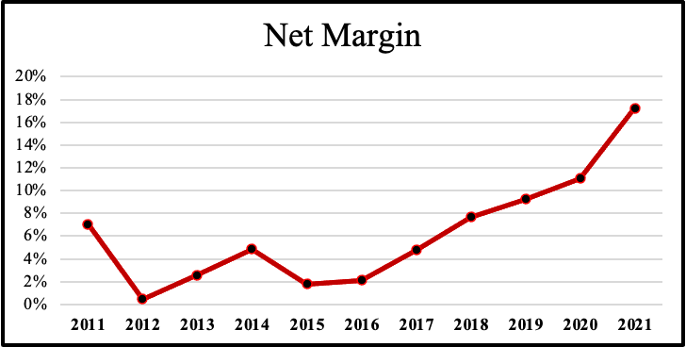
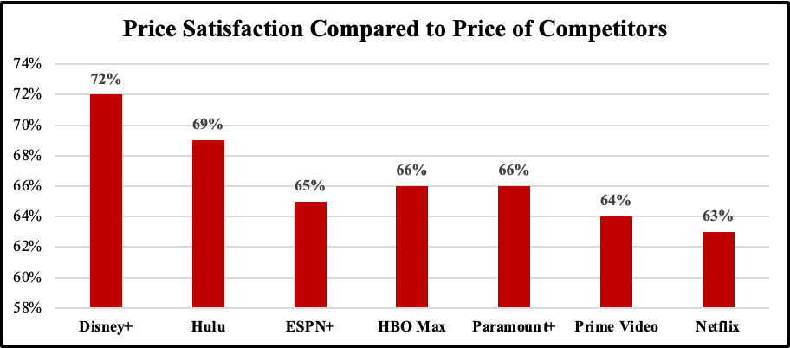

H1: Netflix can increase market share by decreasing cost
ACCEPTED
Assumption 1: Margin is high enough to sustain lower cost
Assumption 3: Users are not satisfied with cost
Assumption 2: Decreasing cost will attract more people to the platform
Netflix recently launched a trial in India in which they decreased prices. The subscription prices were extremely high in the current market. By dropping prices they were able to increase the number of new subscribers and engagement. The trial has recently been expanded to other countries, including the US, in October of 2022. Because the launch is recent, there is no data to on its success in the US market.
Additional Analysis
Netflix has responded to this strategic issue and is attempting to respond to it. Although the hypothesis is likely true we will focus on other potential drivers that have yet to be identified or tested.
8
*See appendix for cost data of streaming service

Slide 10
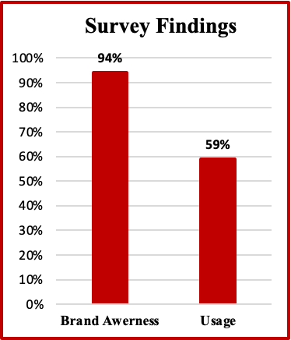

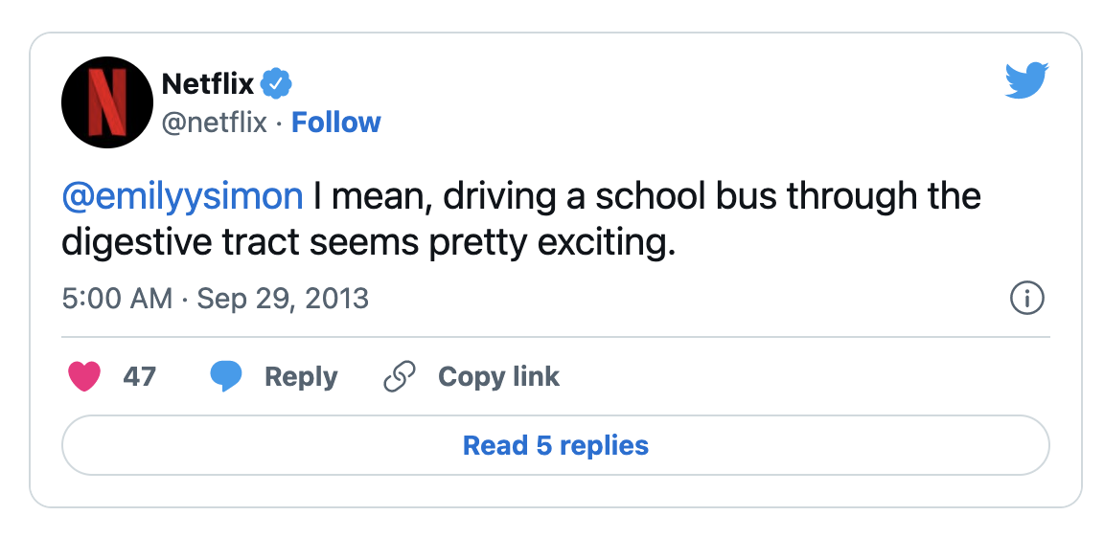
REJECTED
H2: Netflix can increase market share by increasing marketing efforts
Assumption 1: Netflix has the resources increase marketing budget
Netflix has a well established marketing department that focus on activities including advertisement, SEO, and social media marketing. Based on profit margin analysis it can be assumed that they have the resources to expand.
Assumption 2: Marketing would be effective at customer conversion
Although netflix marketing has been successful, high brand awareness and lowering market share implies low conversion.
Assumption 3: Marketing would be successful at reaching new segments that are unaware of offerings
Netflix is a brand with extremely high awareness, especially compared to competitors. It would be extremely costly and time consuming to reach full awareness and target niche segments.
9
*See appendix for data on marketing budget

Slide 11
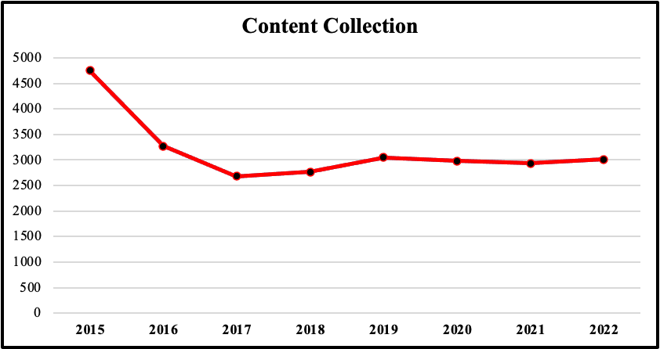
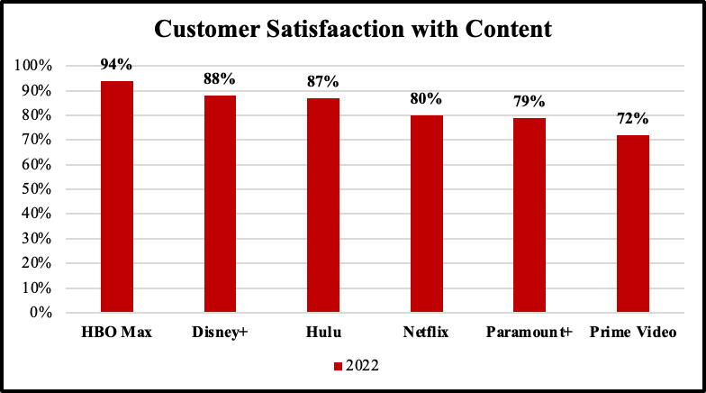
ACCEPTED
H3: Netflix can increase market share improving the quality of content
Assumption 1: There has been a decrease in content
Netflix has lost popular content to competitors and has canceled well performing series
Assumption 2: Users are unsatisfied with current content
Customer satisfaction is lower than biggest competitors and dropped 10% from 2021
Assumption 3: Users value content quality over other features
In a survey conducted on streaming service users, quality of content was rated as one of the top three factors that guided users in their buying decision.
10

Slide 12
Netflix can likely increase market share by renewing canceled series or acquiring unique new content
Score
Redo series that did not perform well
7
Can Netflix improve quality of content in current library?
Renew canceled series that were popular among consumers
12
Can Netflix improve consumer satisfaction by targeting canceled series?
Can Netflix increase market share by 15% in the next 5 years by improving the quality of content?
Stop canceling series that are popular among consumers
11
Produce better quality original series and movies
11
Can Netflix add more quality content to library?
Acquire content that no competitor has
13
Can Netflix acquire better quality titles?
Acquire content that other competitors have
8
11
*See appendix for score breakdown

Slide 13
Solution 1- Renew canceled series that were popular among consumers
Where to play?
This strategy can be offered to standard and premium subscribers. Netflix should focus on content specifically in the US market.
How to win?
Work collaborative with consumer and find funs ways to allow them to give input on which series will be renewed and what plotlines are most interesting. By doing this Netflix will increase satisfaction and draw in new customers. This system will differentiate Netflix from other streaming services and create a new value adding features for customers.
How to earn?
Identify popular series that can be renewed that also have low production cost. Use this offering to convince users to purchase higher priced subscription plans which will have a positive effect on revenues and product mix. This will also draw subscribers to the platform, which will increase sales volumes and revenues.
12

Slide 14
Can Netflix increase market share by renewing canceled series that were popular among consumers?
The Strategy Netflix would evaluate the original series that have been canceled. They would then determine which shows have the highest potential to perform. Netflix would then invest in producing new seasons of these shows and promote this to consumers.
Assumptions | Analysis | Data
Resources are available to renew these series. (EX: cast, writers, directors, budget) | Analyze supplier data and conduct outreach Get quotes on the cost required | - Financial statements - Supplier reports
Users will value these series over current/new content | Analyze users preferences and behavior Use past data to predict future user needs that could be satisfied | - Streaming data - Viewing data - Consumer feedback
Series renewal will attract new consumers to the to the platform. | Analyze the preferences and motivations of consumers in the entire market Estimate potential reach and impact | - Market data - Consumer feedback - Competitors data
Netflix can successfully market new offerings to consumers | Analyse marketing data Estimate market size and penetration rate | - Marketing efficiency research - Market channel research - Marketing reports
13

Slide 15
Solution 2- Acquire content that other competitors do not have
Where to play?
This strategy can be applied to all segments. Netflix should focus on content specifically in the US market.
How to win?
Form exclusive partnerships with content providers, and negotiate contracts that will make Netflix an exclusive provider. Netflix should focus marketing efforts on uncaptured consumer segments. This will increase differentiation and draw new users to the platform while also adding value for current consumers to limit those who might cancel the subscription in the future.
How to earn?
Identify popular content that is most cost efficient to procure (invest in shows with positive profit margin when looking at potential revenues they would bring in). Create deals with suppliers and hopefully decrease prices. Properly develop marketing strategy so that new subscribers are drawn to the platform. This will increase revenues and profits.
14

Slide 16
Can Netflix increase market share by acquiring content that other competitors do not have?
The Strategy Netflix reach out to different suppliers and negotiate contracts so that they gain access to new content. This content would be exclusive to Netflix only, increasing the company’s competitive advantage. They would then promote new content offerings.
Assumptions | Analysis | Data
Content is available for acquisition | Reach out to supplier and analyze data on pricing and availability | - Supplier data - Market data
Netflix has the budget to acquire new content | Analyze profits and revenues over time and predict future revenue surplus to determine budget | - Yearly reports - Revenue data - Profit data
Netflix can determine which content users value most | Analyze user data and and publicly available sources to determine user taste | - User data (watch time and interaction) - Market data - Social Media - New and public sources
New content will draw in new subscribers to the platform | Analyze market and the needs of new target segments | - Market data - User data - Competitor data
15

Slide 17
Appendix

Slide 18
Appendix 1
Criteria | Potential Impact on Target Segments | Expected Occurrence | Overall Score | Explanation
Policies | 5 | 1 | 6 | Unlikely cause because there have been no significant policy changes
Technical Issues | 4 | 2 | 6 | Reports of bad customer service but technical issues are infrequent
Marketing | 4 | 5 | 9 | Little marketing efforts and low budget create areas for improvement; high brand awareness.
Bad Content | 5 | 5 | 10 | Cancelation of popular series and loss of big titles to other platforms leaving many customers unhappy
Volume of Content | 4 | 1 | 5 | Unlikely issue, Netflix has largest content collection of any streaming platform
Relative Cost | 4 | 4 | 8 | Among the highest cost in the industry for each plan. Likely to be a customer pain point
Low Differentiation | 4 | 3 | 7 | Unlikely due to high differentiation of content and recommendation software
General Economy | 2 | 5 | 7 | Unlikely to have a significant effect on purchasing behavior because streaming services are an inelastic good
17

Slide 19
Appendix 2
Cost Efficiency
Potential User Value
Feasibility
Competitive Advantage
Generation
Overall
Score
Explanation
Redo series that did not perform well
7
Extremely time consuming and costly, offers limited value.
Renew canceled series that were popular among consumers
12
Applying preferences would be highly valuable to consumers. Potential to draw in previous and new consumers.
Stop canceling series that are popular among consumers
11
Easy to mitigate future dissatisfaction but users would be unaware of this strategy and it is hard to communicate.
Produce better quality series and movies
11
Could be extremity costly. Hard to measure satisfaction. High effort to determine what users desire.
Acquire content that no competitor has
13
Likely to be costly. This would establish an extreme competitive advantage. High differentiation.
Acquire content that competitors have
8
Extremely costly to by others out and limited differentiation if sharing series with competitors.
18
Notes:
Add explanations

Slide 20
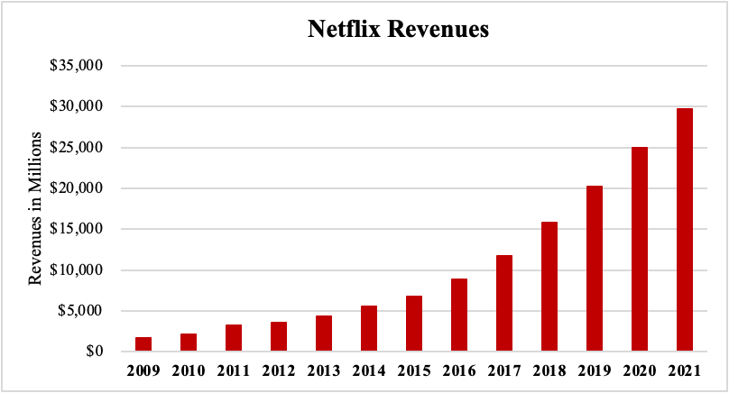
The company performs extremely well each year and has experienced significant revenue gains
Appendix 3
21

Slide 21
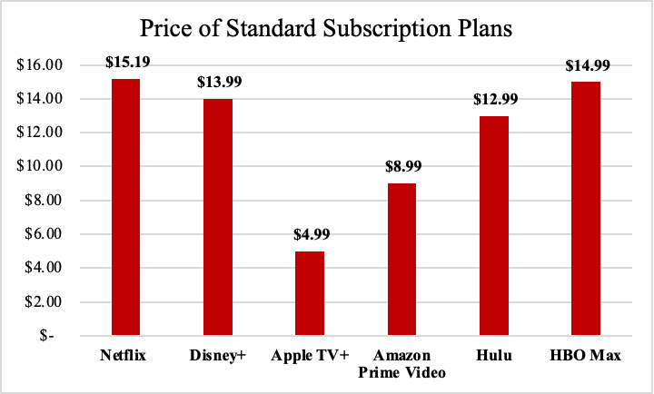
Netflix has the highest cost for a standard plan out of all streaming services
Appendix 4
19

Slide 22
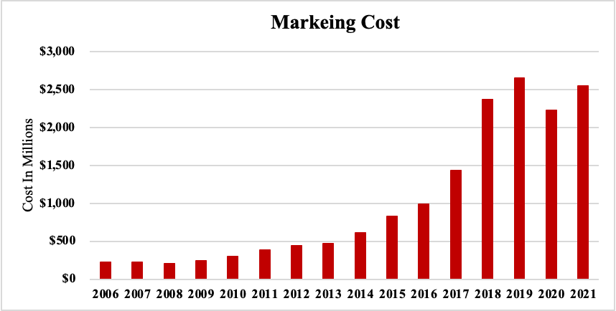
Marketing budget has seen little growth in recent years
Appendix 4
20

Slide 23
Works Cited
https://www.forbes.com/sites/bethkindig/2022/07/22/netflix-stock-stronger-than-it-seems-following-q2-earnings/?sh=4dff60a6198d
https://www.statista.com/statistics/250934/quarterly-number-of-netflix-streaming-subscribers-worldwide/#:~:text=Quarterly%20Netflix%20subscribers%20count%20worldwide%202013%2D2022&text=Netflix%20had%20approximately%20223%20million,compared%20with%20the%20previous20quarter
https://www.exchange4media.com/digital-news/we-have-seen-a-nice-uptick-in-engagement-in-india-after-price-cut-119813.html
https://about.netflix.com/en/news/announcing-basic-with-ads-us
https://www.cabletv.com/blog/best-on-demand-streaming-tv-providers-in-customer-satisfaction
https://buildd.co/marketing/netflix-marketing-strategy
https://www.statista.com/forecasts/1305033/netflix-video-on-demand-brand-profile-in-the-united-states#:~:text=How%20high%20is%20the%20brand,and%20the%20written%20brand%20name.
https://variety.com/2022/digital/news/netflix-lowest-value-must-have-service-survey-1235301080/
https://www.whats-on-netflix.com/news/netflixs-movie-library-has-shrunk-by-35-since-2015-but-is-growing-again/
https://www.macrotrends.net/stocks/charts/NFLX/netflix/profit-margins#:~:text=Current%20and%20historical%20gross%20margin,30%2C%202022%20is%2016.03%25
https://www.businessinsider.nl/netflix-market-share-of-global-streaming-subscribers-dropping-ampere-2020-1/
https://statstic.com/marketing-expenses-of-netflix/
https://www.moneygeek.com/financial-planning/resources/best-streaming-services-on-a-budget/
21

